Slide 1
International Infection Prevention Week
Nursing Unit Toolkit

Slide 2
Suggestions for Unit Leaders
During International Infection Prevention Week (Oct 15-21, 2023), use this toolkit to engage staff in Infection Prevention topics
Post completed toolkit slides on huddle boards
Reserve a GloGerm/GlitterBug kit from HEIP (quantities limited)
Encourage staff to complete the HEIP Staff Education Survey
Support staff in attending an International Infection Prevention Week event
Thank your Infection Preventionist!

Slide 4
CELEBRATE the
FUNDAMENTALS of
October 15-21, 2023
Ip
INFECTION
PREVENTION
HAND
HYGIENE
CLEANING &
DISINFECTION
INJECTION
SAFETY
VACCINATION
PPE
PREVENT INFECTIONS, SAVE LIVES

Slide 5
NURSING UNIT:
FY24 CLABSI #:
FY24 CAUTI #:
FY24 C. DIFF #:

Slide 6
WE ARE FOCUSING ON MAINTAINING:
Check all that apply: | CLABSI | CAUTI | C. DIFF
Tactics We are focusing on these HAI prevention measures: |  |  | (e.g. Hand Hygiene)

Slide 7
WE ARE FOCUSING ON REDUCING:
Check all that apply: | CLABSI | CAUTI | C. DIFF
Tactics We are focusing on these HAI prevention measures: |  |  | (e.g. Hand Hygiene)

Slide 8
OUR HAND HYGIENE COMPLIANCE LAST MONTH WAS: ____________ %
WE ARE: (check one) | DOING GREAT! | LOOKING TO IMPROVE

Slide 9
GloGerm Demonstration Instructions Contact HEIP for supplies (x34343)- 2 days notice required
Shake bottle and dispense a dime-sized drop into the palm of one hand
Spread completely over both hands, including under nails, around cuticles, and between fingers, as if applying hand lotion
In a dark room, place hands under UV light to view “glowing germs” that exist before hand washing
Clean hands with soap and water
Scan to watch proper technique:
Place hands under UV light
Hands are very clean if there are no remaining “glowing germs”
Bright spots show hard-to-clean cracks and crevices
CAUTION: Avoid use on persons with known skin allergies. Do not allow lotion to contact clothing as staining may result.

Slide 10
Infection Prevention Tip of the Day

Slide 11
Infection Prevention Tip of the Day
The single most effective way to prevent the spread of infections.
Alcohol-based hand rub kills germs on hands. Soap and water washes them away.
Soap and water reduces the amount of contaminants on your hands.
Nail maintenance is a key aspect of hand hygiene.

Slide 12
Infection Prevention Tip of the Day
Cleaning visible dirt and debris off surfaces is an essential first step to disinfection and sterilization.
Mixing chemicals can be dangerous. Always follow manufacturer’s instructions for use (IFU) for the disinfectant you are using.
Always follow the manufacturer’s instructions for use (IFU) for the device you are cleaning.

Slide 13
Infection Prevention Tip of the Day
Vaccination protects the people who receive them and also those around them.
It may still be possible to get an infectious disease even after being vaccinated for it.
Vaccines can decrease the severity of illness and the likelihood of hospitalization and death from the illness.

Slide 14
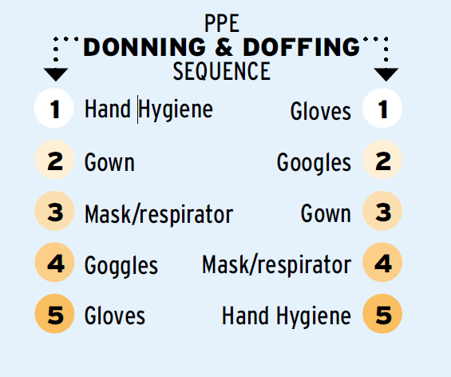
Infection Prevention Tip of the Day
Use PPE whenever there is an expectation of possible exposure to infectious material.
Know the sequence of putting on and taking off PPE to reduce the risk of contamination.
Gloves are not a substitute for hand hygiene.

Slide 15
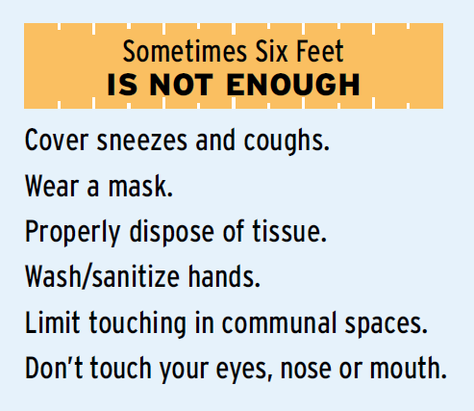
Infection Prevention Tip of the Day
Covering coughs and sneezes helps prevent the spread of germs that cause serious respiratory illnesses.
Respiratory season extends beyond winter. Be prepared 365 days a year.
Have tools for success: tissues, masks, soap and water, hand sanitizer, and trash receptacles.

Slide 16
Infection Prevention Tip of the Day
Protect yourself from sticks: Use a sharps device with safety features.
Prevent bloodborne pathogen transmission: Clean and disinfect glucometers with every use.
Technique matters: Injection safety requires an aseptic or sterile technique.

Slide 17
Hospital Epidemiology & Infection Prevention
International Infection Prevention Week
Meet your Infection Preventionists
Hand Hygiene Campaign Contest Showcase and Winner Unveiling
Flu Shots for Staff provided by OHS
Games, Trivia, and Prizes!
Take our staff education survey and receive a prize*! Scan the QR Code: *Must be present to win

